Slide 1
Lake Travis FFA Alumni
November 2, 2021

Slide 2
Agenda
Welcome
Minutes
Financial Report
Teacher Update
Past Month’s Event Recap (Homecoming, P Terry’s, Pet Shot Clinic)
Sponsorship Drive/Fundraising Update
Upcoming Events (Majors, LDEs, Chapter Show, Cav Classic, TCYS)
New Business
Upcoming Dates and Deadlines
Questions, Reminders, Adjourn

Slide 3
Minutes
Erica Koss
The minutes of the previous meeting are posted online. Do we have a motion to accept the minutes as posted?

Slide 4
Financial Report
Jenn De Leon
Expenses: $829.40
Banking Software $26.65
Insurance $395
Postage $40
Student Support: $125
Signs / Decals: $175.90
Income: $2,724
Membership: $800
Sponsorship: $1,750
Signs / Decals: $174 ($ update)
Pending: Pet Shot Clinic, Spirit Night, Sponsorships

Slide 5
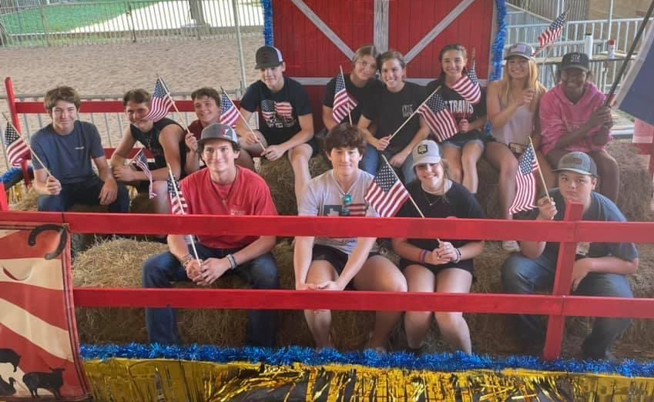
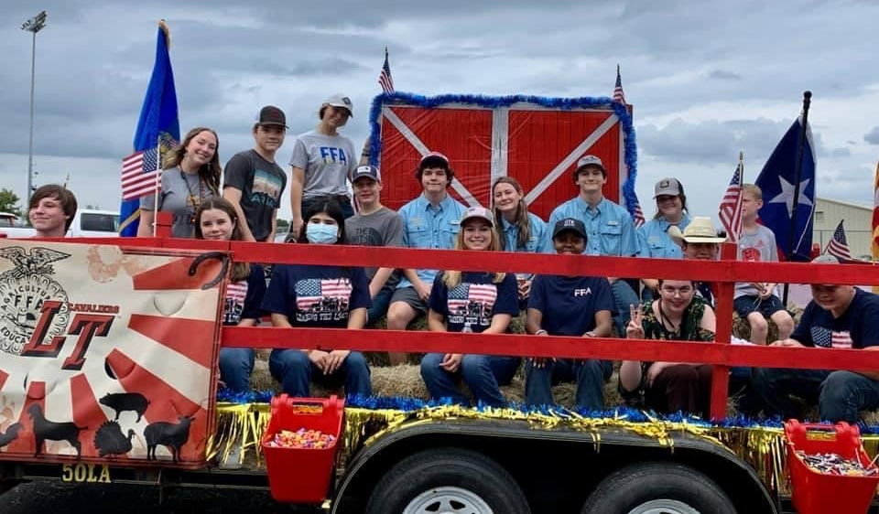
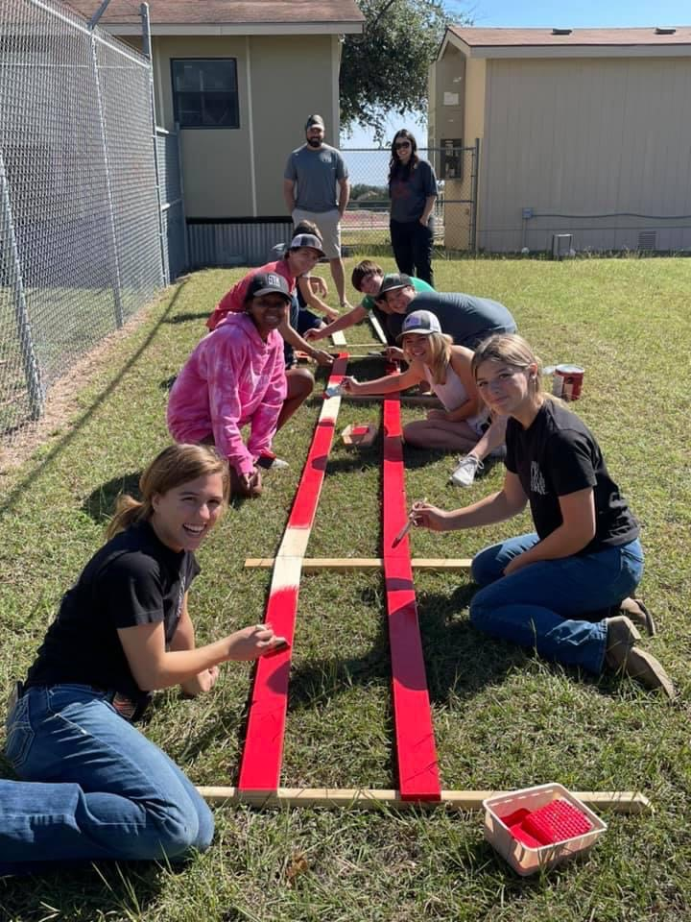
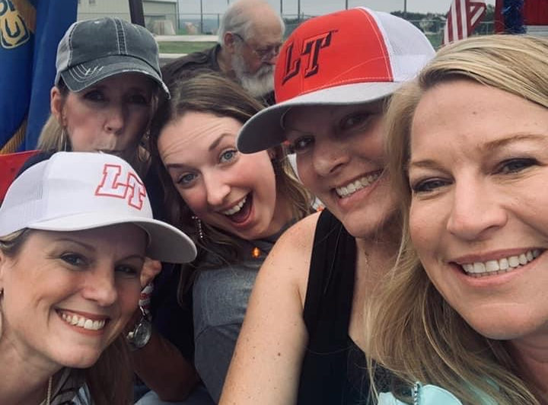
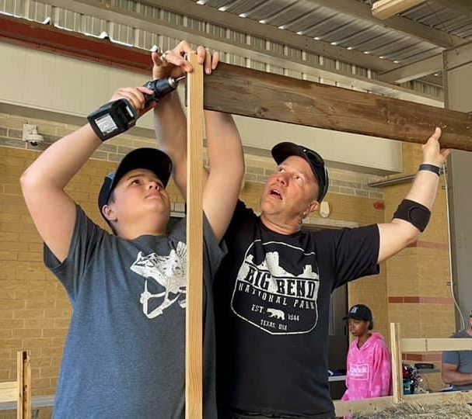
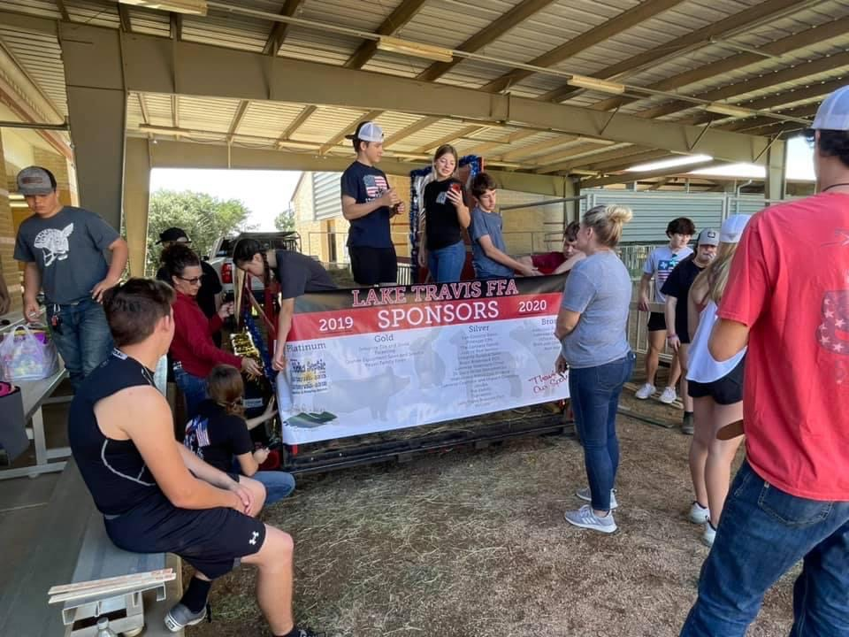
Homecoming Float Success!
THANK YOU to our Chairs!!!
Susan Dow and Kelli Beck
Vanessa Jackson

Slide 6
Teacher Update
P. White
Homecoming Float! WOW! Thank you!
Pet Shot Clinic! WOW! Thank you to our volunteers!
LDE Competitions Nov 9th, we will leave at 9:00am and return late that night.
Nov. 6 volunteer event for kids if interested, students have info
Nov 13 is Pig Validation-Please be here by 9:30am
Clean pens, clean up pigs, sweep, fill out paperwork. Wait patiently!
Every student must be here and have a parent present.

Slide 7
Teacher Update
P. White
Parking at barn- During school hours vehicles are to remain parked.
Parents and Students - Please observe-no parking in bus lane marked no parking zones and in front of Pig Barn Alley. Handicap parking spots are not valid parking spots without Handicap placard or Bus lane, unless you are in a Bus.
Students are not allowed to ride in backs of truck on campus
We love kids but the parking lot will not be a stereo thump fest after school hangout.
Pen rent and deposits must be paid. Get with K White ASAP!
All FFA members must have a signed barn contract and signed acknowledgement that student and parents have read LTFFA student handbook to participate in FFA activities.

Slide 8
Teacher Update
P. White
Working to schedule showmanship clinics -- stay tuned
Barn Issues … DAILY Clean up, scoop up, sweep up keep tack rooms tidy! Illness breeds in dirty pens and dirty barns!
Please report any problems to the teachers, we can’t fix what we don’t know is broken.
Eligibility -- Dec. 16 deadline for TCYS Everyone is eligible for Cav Classic and Chapter due to winter break. Encourage students to all be passing and not holding our breath over the break!

Slide 9
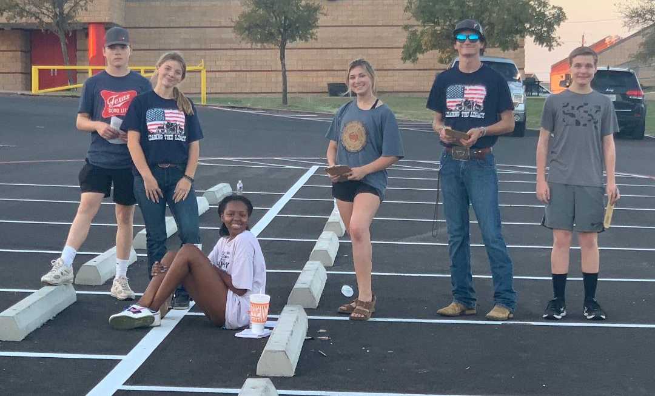
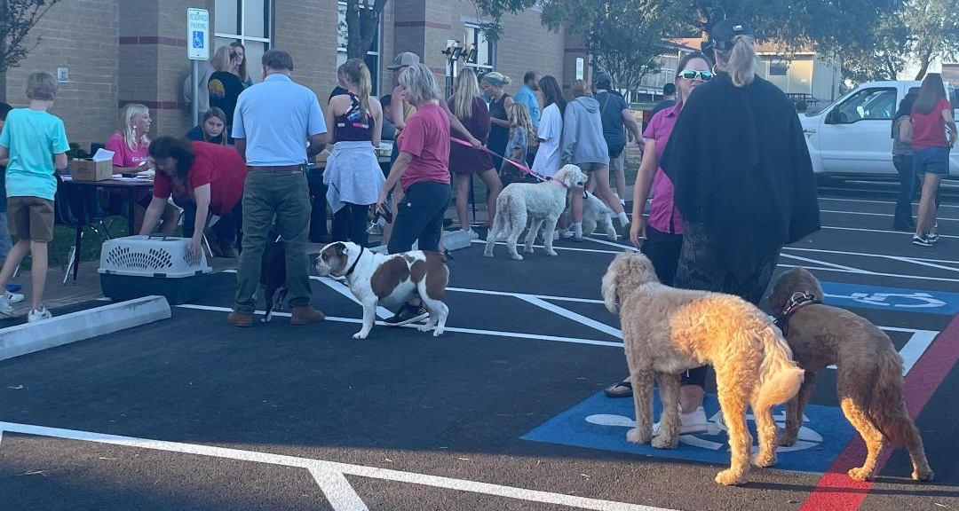
Pet Shop Clinic Success!
THANK YOU to our Chair!!!
Aline Crompton
THANK YOU to all our volunteers!!!
We raised over
$4,000!

Slide 10
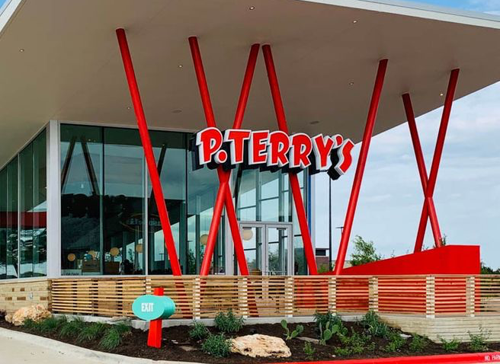
P Terry’s Fundraiser Success !
We raised
$341.00
One of our largest Spirit Nights yet!
Drum roll please …

Slide 11
Fundraising/Sponsorships
Jenn De Leon
Sponsorship Drive Update
The Dream…..
Homework - Each family emails assigned sponsors
GOAL - funds turned in by November Meeting
GOAL - each family raises at least $500
Reality….
Technical difficulties with instruction emails
Emails sent out….. 10 families
In-person visits….. 1 family
14 sponsorship forms submitted
$30 - $2,500
even mix of businesses & friends/family
Current Total = $6,130

Slide 12
2021 - 2022 LT FFA Sponsors
THANK YOU!!!
Bronze
Lakeway Orthodontics
McCoys Building Supply
Triple S Feed & General Store
Silver
Flipnastics
Wild Hare Construction & Remodeling
Diamond
Shipp Family Dentistry
Shout Out: Brice Group Architects

Slide 13
2021 - 2022 LT FFA Sponsors
THANK YOU - FRIENDS & FAMILY!!!
Bronze
The Hatfield Family
Silver
The Cohen-Wise Family
Gold
The Foxx Family

Slide 14
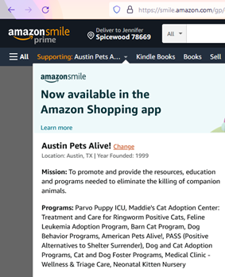
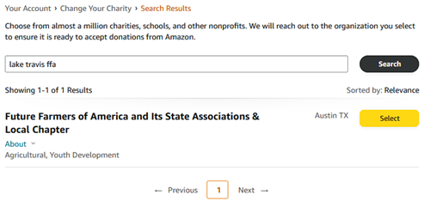
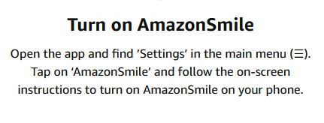
Fundraising / Amazon Smile
Update your account to support LT FFA!!
Use the Amazon app?

Slide 15
Major Shows
Entry fees due THIS FRIDAY November 5th
Can be found on the Lake Travis FFA Website
Major shows are terminal (once your animal goes in, your animals doesn’t come back to the LTHS Ag Facility)
Teacher(s) will be available for questions on November 3rd & 4th
The Ag Teachers ONLY trailer to San Antonio

Slide 16
LDEs
Leadership Development Events
District Competition: Next Tuesday, November 9, 2021
Area Competition: Saturday, November 20, 2021
Official Dress is needed (can borrow jacket from teachers)
Practices are happening AT THE AG FACILITY
Sign-up WAS outside the office

Slide 17
Lake Travis FFA Chapter Show
December 16th: registration & weight cards due
December 17th: actual show (Midterm Week)
AT RANCH PARK IN DRIPPING SPRINGS
Cost = $20/head
Looking for buckle sponsors!! Only $150 (see K White)!!

Slide 18
Lake Travis FFA Cavalier Classic
Alisia Fee
December 18, 2021
Dripping Springs Ranch Park
School will trailer there on Friday and back to school Saturday night/Sunday morning (TBD)
Pens available for all species on-site
Volunteer signups available at November and December meeting
All parents and students asked to volunteer at least one shift!

Slide 19
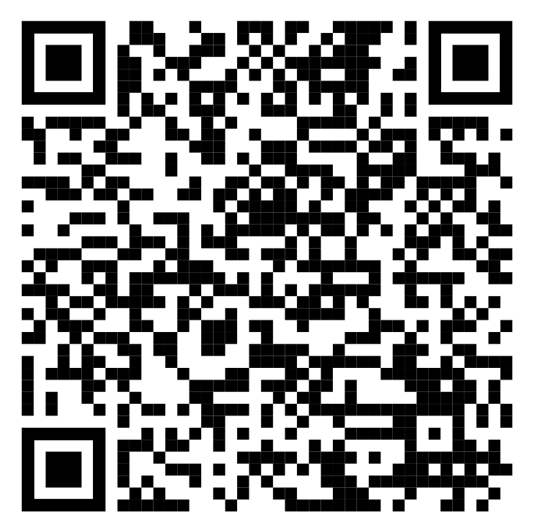
Cav Classic Volunteers Needed
Alisia Fee
Volunteer Sign Up:
https://docs.google.com/spreadsheets/d/1V1mjL-kQ7D4OL0rhsG4O3ACe30uZzqhiuLlTsnk90pg/edit?usp=sharing
We need 22 volunteers at a time.
Break down
Per species:
3 ringside table
4 - 5 running gates/in the ring
4 per time slot (4 hours shifts) for concessions

Slide 20
TCYS Updates
Jenn DeLeon
Congrats to Briannah Noak and Taylor Sulak for being selected as Jr. Superintendents for 2022
Location still TBD -- Expo Center or Dripping Springs Ranch Park
School will trailer our animals
January 13-16
Check Youth Fair Rules carefully
Need to know who will want an RV
Volunteer signups at December and January meetings (Kendall will be reaching out for cantina assistance)
All parents and students must be there for pen set-up/tear down

Slide 21
New Business
Jenn Deleon
Shutterfly Christmas Card (in lieu of buyer letters) -- need a chair
RV Rentals for TCYS -- how many?

Slide 22
Upcoming Dates & Deadlines
Vanessa Jackson
ASAP = Pen Rents and Deposits Due to K White
ASAP = Talk to Aline Crompton if ordering bunnies
November 5 = Major Show Entries due
November 9 = Capital District LDE competition
November 12 = Quality Counts complete (for first year members and freshman)
November 13 = Pig Validation
November 20 = Area LDE competition
December 7 = Alumni Meeting
December 16 = Grades get checked
December 17 = LT FFA Chapter Show
December 18 = Cavalier Classic
January 13-15, 2022 = TCYS

Slide 23
Membership Reminders
Erica Koss
Sign-in and double check info
Please complete membership forms ASAP

Slide 24

Join Remind Group Alerts
Text number: 81010
•FFA Texts - @lt-ffa
•Pigs - @oinker
•Goats - @goat
•Lambs - @ltlambs

Slide 25
Next Meeting Dec 7 (6pm)
Meeting
Adjourned
Thank you for attending!

